Slide 1
Determination of hematocrit (PCV)

Slide 2
Hematocrit
Hematocrit: is the proportion of blood volume that is occupied by erythrocytes (the ratio of red blood cells to the whole blood volume).
It is usually expressed as a percentage.

Slide 3
Relevance
Measurement of hematocrit (Hct) or packed cell volume (PCV) is the most accurate and simplest of all tests for detecting the presence and degree of anemia or polycythemia.
In comparison, hemoglobin estimation is less accurate, and RBC count far less accurate.

Slide 4
Relevance
Also, if Hb, RBC count, and PCV are determined at the same time, various absolute corpuscular values (e.g., volume and Hb content of a single red cell) of a person can be determined.
These values help in the laboratory diagnosis of the type of anemia in a person.
Notes:
MCV (mean cell volume)= PCV *10/number of RBC (in million)
Iron deficiency anemia (microcyte RBC)
B12 & folic acid deficiency (Macrocyte RBC)
MCH (mean cell haemoglobin)= haemoglobin (g%)*10/number of RBC in million
Norma value of MCH= 27-33 pg (pictogram or micromicrogram , µµg)
hypocrochromic (less than normal, like iron deficiency anemia- microcytic RBC)
Normochromic (with in the normal range, like normal individual & B12 deficiency anemia-macrocytic RBC)

Slide 5
Normal values
The average levels and their ranges are as follows:
Males: (38-50) %, (44 %).
Females: (36–45) %, (42 %).

Slide 6
Increased PCV
Polycythemia vera (primary polycythemia)
Secondary polycythemia
Polycythemia due to hemoconcentration
Physiological polycythemia

Slide 7
Decreased PCV
Medications
Genetic conditions
Bleeding
Medical conditions
Nutritional deficiencies
Physiological conditions

Slide 8
Apparatus and materials
Heparinized capillary tubes
Microhematocrit centrifuge
Microhematocrit reader
Modeling clay sealant
Blood lancet, sterile cotton/ gauze swabs, 70% alcohol

Slide 9
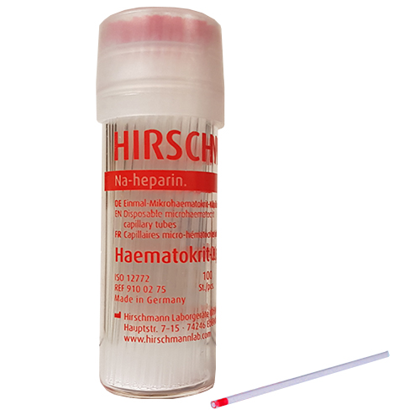

Slide 10
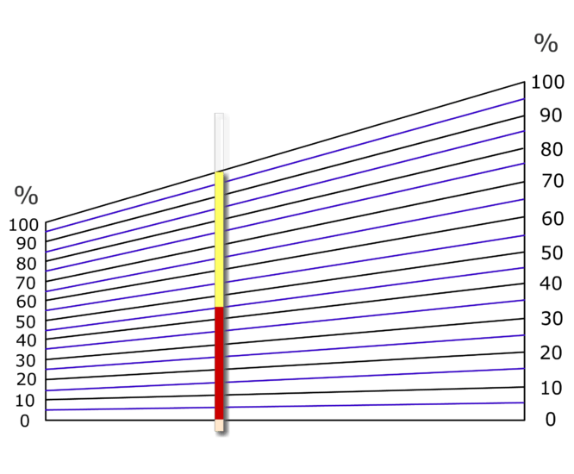

Slide 11
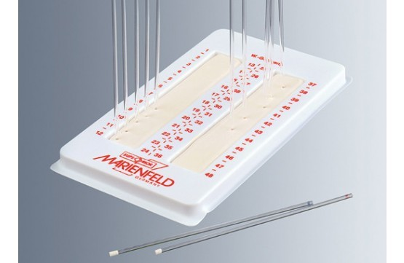

Slide 12
Procedure
Puncture the skin of the finger for collecting blood, directly fill 2/3 of heparinized microhaematocrit tube with blood.
Seal one end of the tube with clay.
Notes:
To ensure proper mixing of cells and plasma (inaccurate results are likely if this precaution is not taken).
To oxygenate blood cells to remove CO2 (red cells are larger when CO2 is high, in venous blood).

Slide 13
Procedure
Place the filled tube in the microhematocrit centrifuge, with the plugged end away from the center of the centrifuge and centrifuge at a preset speed of 10,000 to12,000 rpm for 5 minutes.
Notes:
To ensure proper mixing of cells and plasma (inaccurate results are likely if this precaution is not taken).
To oxygenate blood cells to remove CO2 (red cells are larger when CO2 is high, in venous blood).

Slide 14
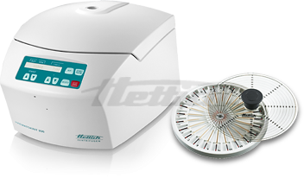
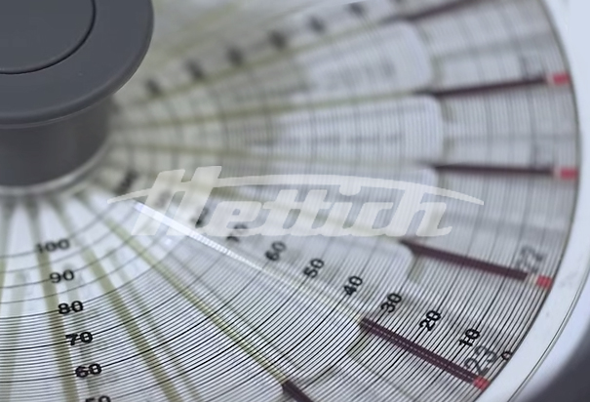
Procedure

Slide 15
Procedure
Place the tube in the microhematocrit reader.
Read the hematocrit by following the manufacturer’s instruction on the microhematocrit reading device.
Notes:
To ensure proper mixing of cells and plasma (inaccurate results are likely if this precaution is not taken).
To oxygenate blood cells to remove CO2 (red cells are larger when CO2 is high, in venous blood).

Slide 16
Observations and results
Note that the blood has been separated into 3 layers:
A tall upper layer of clear plasma
Amber or pale yellow-colored.
It should not be pink or red which would indicate hemolysis of red cells in the sample.
If there is hemolysis, the test must be repeated on a fresh sample.
Notes:
Pink- hemolysis
Yellow- jaundice

Slide 17
Observations and results
A greyish layer
White, thin layer (about 1 mm thick), so called “buffy layer”.
Consisting of platelets above and leukocytes below it.
A tall bottom layer of red cells which have been closely packed together.

Slide 18
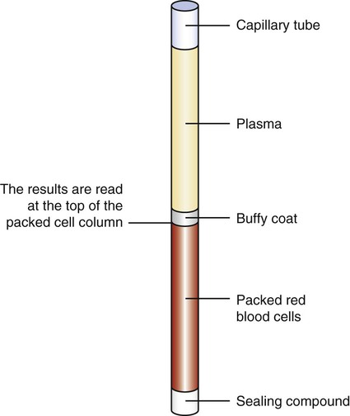

Slide 19
Observations and results
Read the hematocrit as follows;
Place the bottom of the tube along the red line below the scale.
Be sure that the place where the white hematocrit sealer meets the RBC’s is on the line at the bottom of the scale itself.

Slide 20
Observations and results
Move the tube along those lines until the top of the plasma intersects the top line of the scale
The value of the hematocrit is read on the line where the RBC’s meet the plasma.

Slide 21
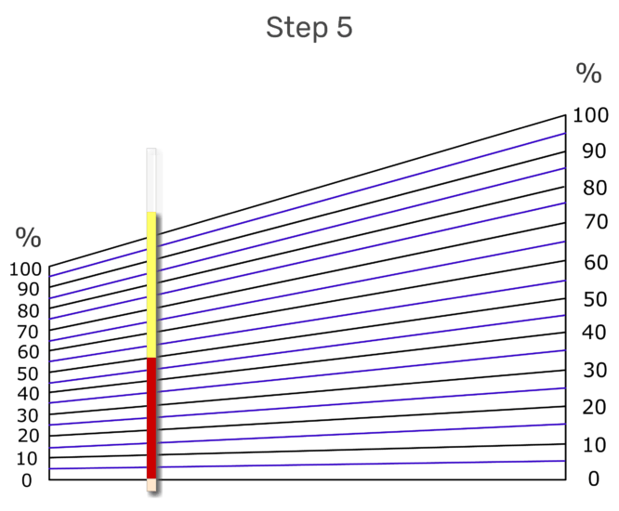
Observations and results

Slide 22
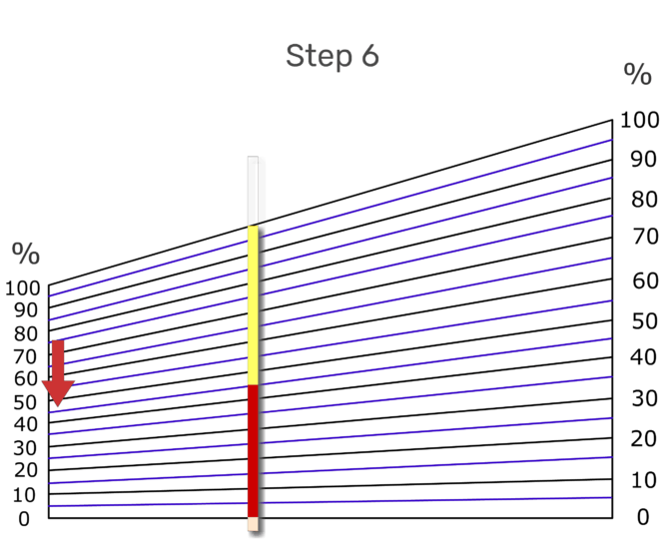
Observations and results

Slide 23
PRECAUTIONS
Use the recommended amount of EDTA as the anticoagulant. There should be no clotting or hemolysis of the blood.
The test should be done within 6–8 hours of collection of the sample.

